Slide 1

Macroeconomics II
Lecture 03 (February 2023)
Stylised facts, concepts
Evidence
Evolution of the Kaldor facts
Reading:
Louçã and Mortágua (2021), chapter 12
1
Notes:
1

Slide 2
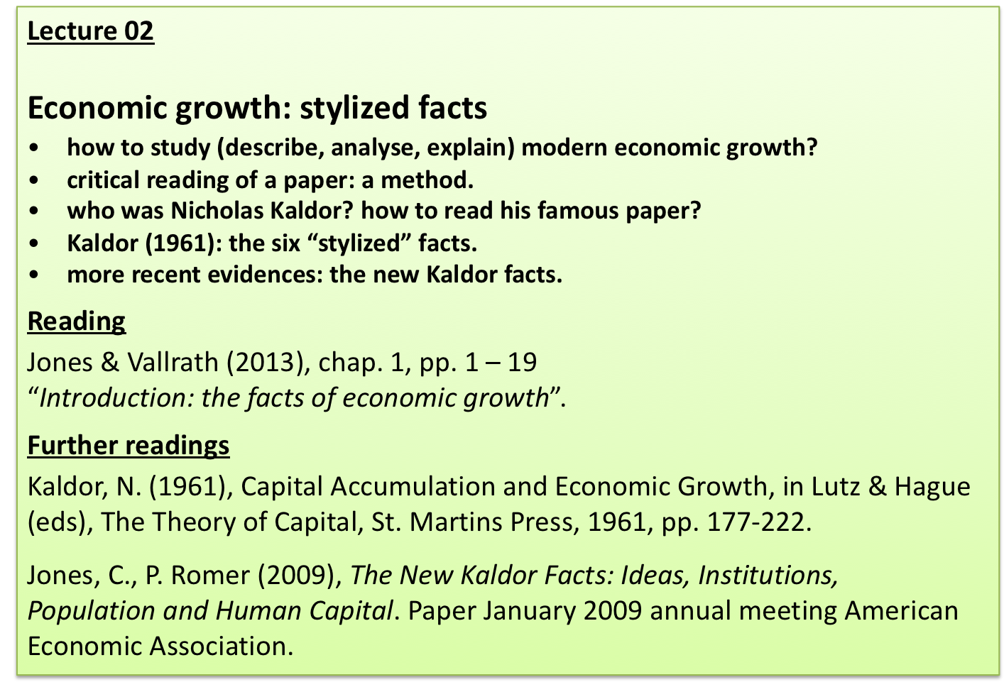
2
Notes:
2

Slide 3
how to investigate economic growth?
we need to “look” at the reality and to find “facts” (trends, stabilities, etc)
facts may be investigated (causes) and such investigation should be supported by some theory (causality relations with other variables).
this requires:
to be clear about what we want to “see”;
to be focussed on that purpose;
to make use of appropriate analytical tools;
3
Notes:
3

Slide 4
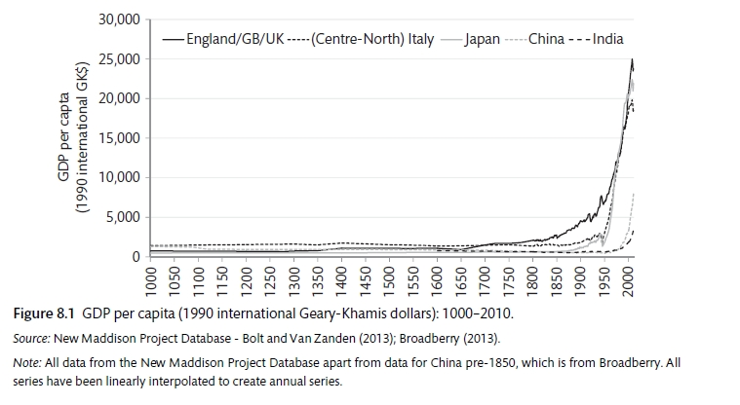
what do we see?
1000 years of economic evolution
4
Notes:
4

Slide 5
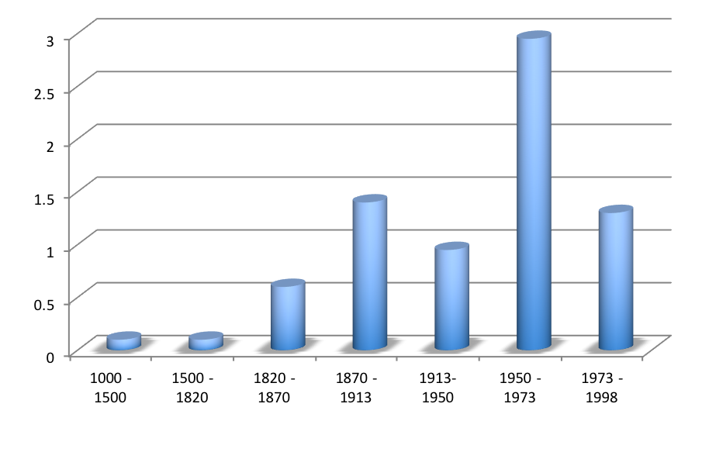
and now?
Growth rate (%) of
GDP per capita
World average
Source: Maddison (2001)
rates of growth
periodization
growth was negligible from the Middle Ages to the Industrial Revolution;
from the early 19th century until WW I growth accelerated dramatically;
WW I and II and the Great Depression slowed down growth;
WW II was followed by the Golden Age of growth, until the early 1970s;
with the outbreak of the recession of the 1970s, growth slowed down.
Notes:
5
FIGURE 3.5 CONVERGENCE IN THE OECD, 1960–2008
SOURCE: Penn World Tables Mark 7.0 and Summers and Heston (1991)

Slide 6
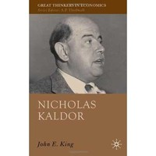
who was Nicholas Kaldor?
Hungarian economist (1908-1986).
Studied economics at LSE (London).
After II WW worked as as Director of Research and Planning at the Economic Commission for Europe
He was consultant for the British government, responsible for the creation of VAT in the UK.
In 1966 moved to Cambridge (UK) University.
Relevant theoretical contributions to welfare
economics (30 years old).
In 1957 (aged 49) published a paper “A model of economic growth” in the Economic Journal. The basic ideas in this paper were developed in “Capital Accumulation and Economic Growth” in 1961.
6
Notes:
6

Slide 7
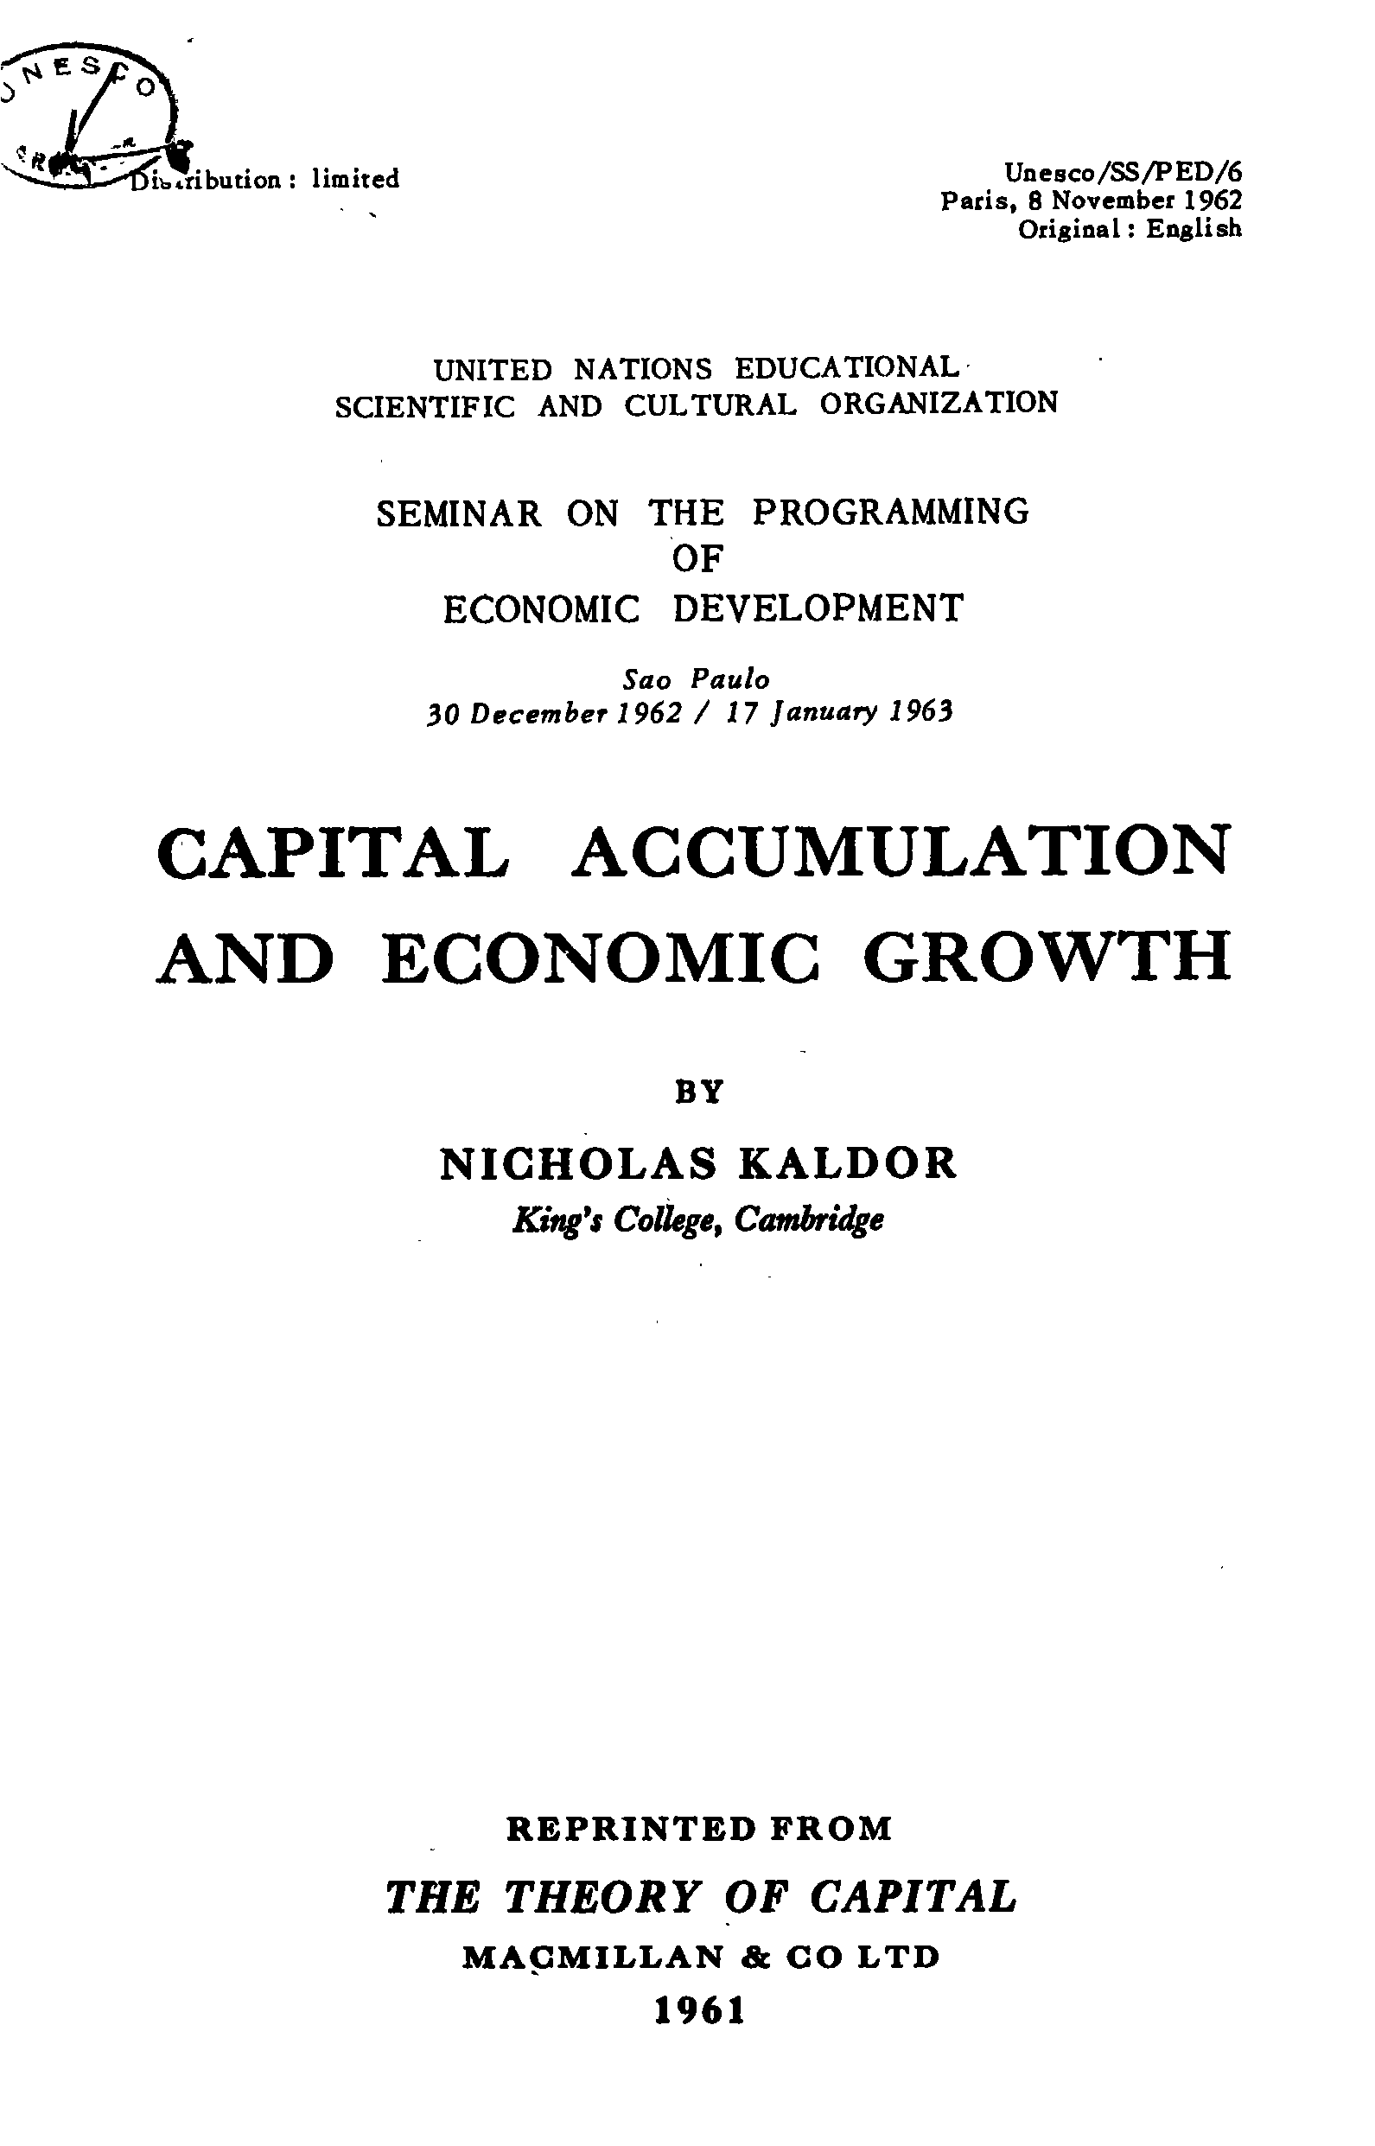
7
Notes:
7

Slide 8
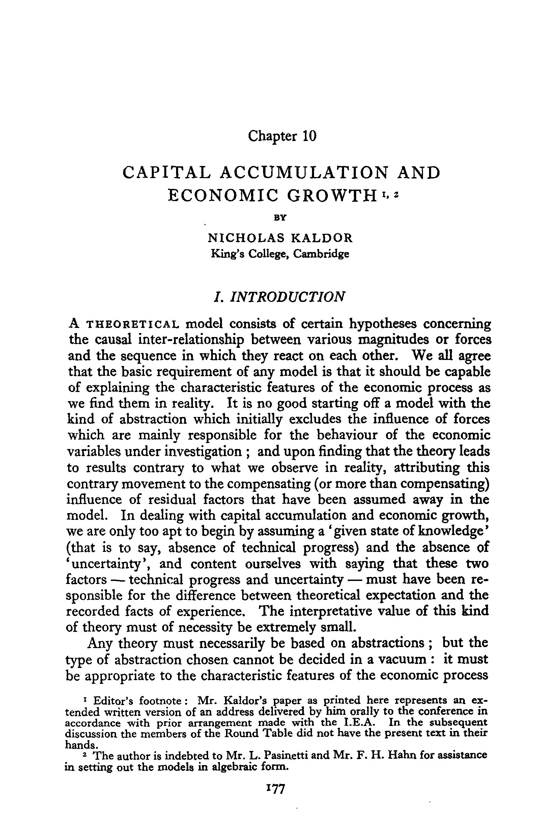
Scientific paper (theoretical)
a theoretical contribution to the method
of creation of a theory that explains
economic growth
the need for a scientific method
(abstraction, with focus on the essential
issues, on what is relevant)
8
Notes:
8

Slide 9
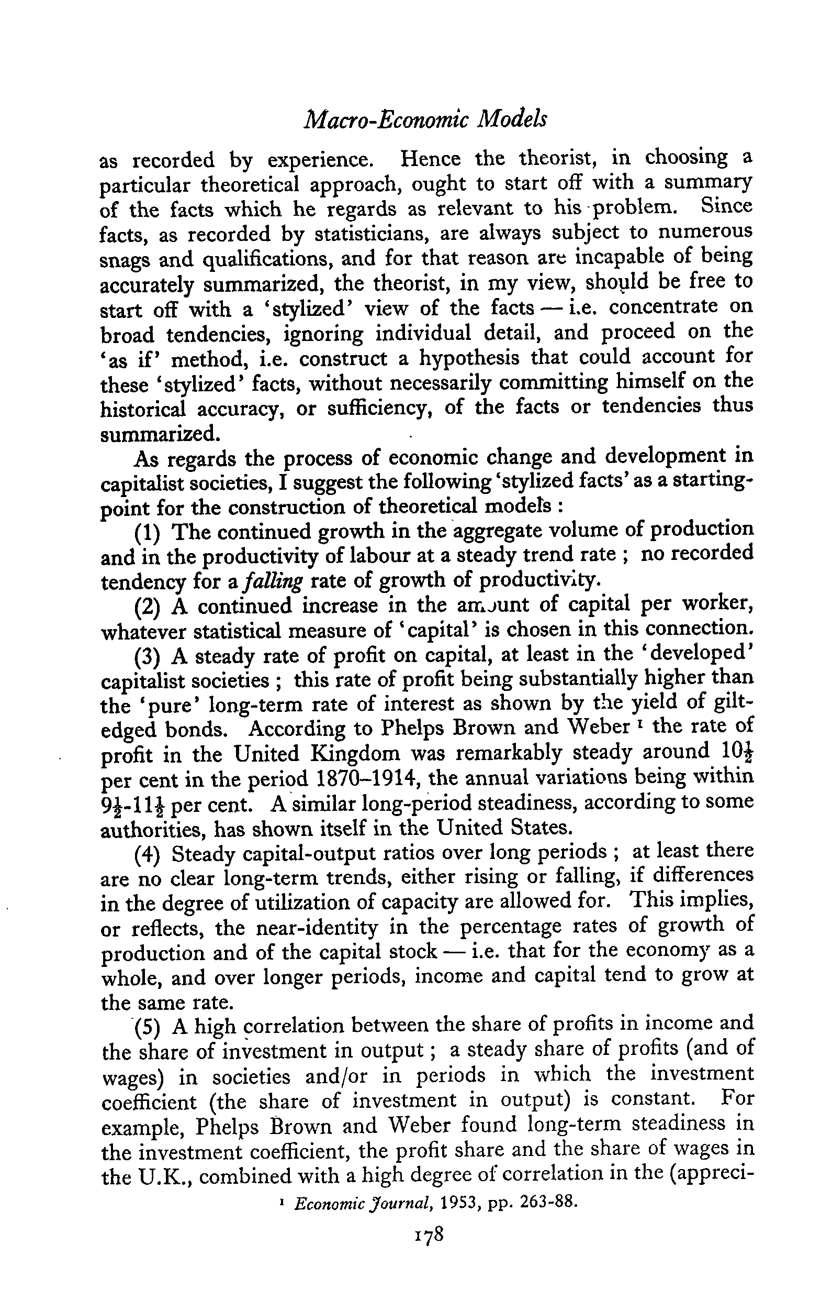
to look at the reality, at what is relevant:
a “stylized” view of the facts, identifying
patterns, ignoring irrelevant details
the six stylized facts as the author
“sees” the reality (in 1961)
he makes use of:
concepts
data
facts (looking at data, using concepts)
9
Notes:
9

Slide 10
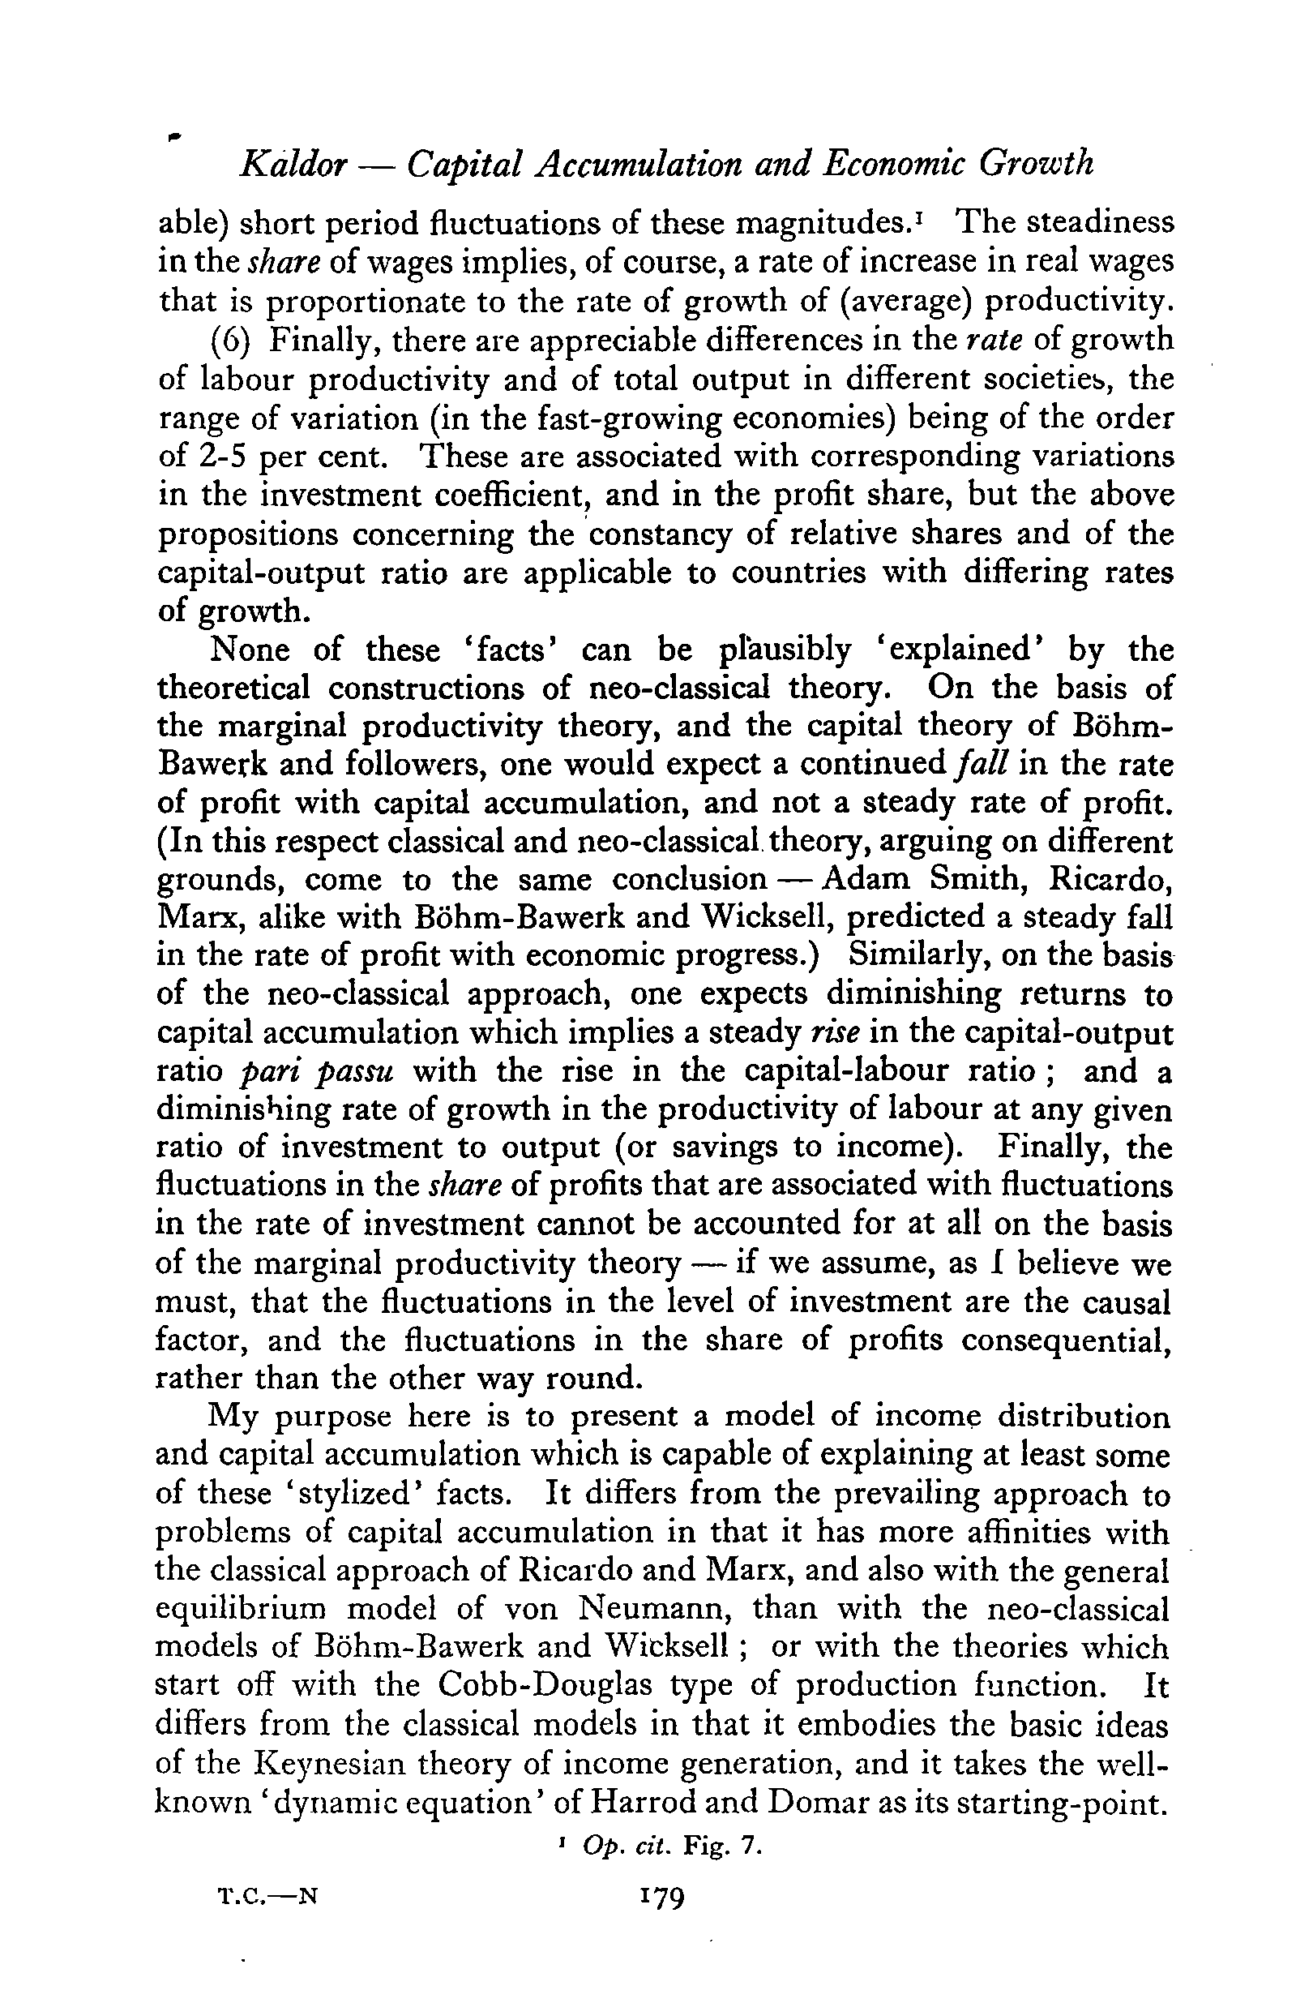
theoretical challenge
if the current neoclassical theory
does not explain
we need a new theory
10
Notes:
10

Slide 11
The 6 stylized facts of growth, according to Kaldor (1961)
1. Labour productivity (Y/L) has grown at a sustained rate.
2. Capital per worker (K/L) has also grown at a sustained rate.
3. The real interest rate or return on capital (r) has been stable.
4. The ratio of capital to output (K/Y) has also been stable.
5. Capital (r.K) and labour (w.L) have captured stable shares of national income (w.L/Y and r.K/Y).
6. Among the fast growing countries of the world, there is an appreciable variation in the rate of growth (g) of the order of 2 to 5 percent.
11
Notes:
11

Slide 12
“Two recent waves of research have changed our views on the subject (economic growth).
One wave started in the mid-1950s and lasted until the early 1970s. The second started in the mid-1980s and continues to this day. Both led to major revisions of the theory and empirics of growth.”
Helpman, E. (2010), The Mystery of Economic Growth. The Belknap Press of Harvard University Press.
12
Notes:
12

Slide 13
New stylised facts as proposed by the literature:
1. There is a large variation in per capita income across countries. The poorest
countries have per capita incomes that are less than 5 percent of per capita incomes
in the richest countries.
2. Rates of economic growth vary substantially across countries.
3. Growth rates are not generally constant over time. For the world as a whole, growth
rates were close to zero over most of history but have increased sharply in the twentieth century. For individual countries, growth rates also change over time.
4. A country’s relative position in the world distribution of per capita incomes is not
immutable. Countries can move from being “poor” to being “rich” and vice versa.
5. In the United States over the last century: a) the real rate of return to capital (r) shows
no trend upward or downward but some oscillations; b) the shares of income to capital (r.K/Y) and labour (w.L/Y) show no trend; and c) the average growth rate of output per person has been positive and relatively constant over time, that is, the USA exhibits steady, sustained per capita income growth;
6. Growth in output and growth in the volume of international trade are closely related.
13
Notes:
13

Slide 14
50 years after Kaldor (1961) ….
Jones, C. I., Romer, P. M. (2009), The New Kaldor Facts: Ideas, Institutions,Population and Human Capital. Paper presented at the January 2009 annual meeting of the American Economic Association
14
Notes:
14

Slide 15
Increased extent of the market
Increased flows of goods, ideas, finance, and people – via globalization as well as urbanization – have increased the extent of the market for all workers and consumers.
15
Notes:
15

Slide 16
2. Accelerating growth
For the two centuries, growth in both population and per capita GDP has accelerated, rising from virtually zero to the relatively rapid rates observed in the last
century.
16
Notes:
16

Slide 17
3. Variation in modern growth rates
The variation in the rate of growth
of per capita GDP increases with
the distance to the technology
frontier.
17
Notes:
17

Slide 18
4. Large income and TFP differences
Differences in measures inputs explain less than half of the enormous cross country differences in per capita GDP.
18
Notes:
18

Slide 19
5. Increases in “human capital” per worker
“Human capital” per worker is rising dramatically throughout
the world.
19
Notes:
19

Slide 20
6. Long-run stability of relative wages
The rising quantity of human capital relative to unskilled labor has not been matched by a sustained decline in its relative price.
20
Notes:
20

Slide 21
relevant questions:
does economic theory respond to such stylized facts incorporating explanatory theories in the bulk of scientific knowledge?
to what extent does the “new” growth theories respond to the “new” stylized facts?
21
Notes:
21

